Slide 1
Starting your project
Analysis 10 marks
Design 15 marks
Developing the coded solution 25 marks
Evaluation 20 marks
More info in
W:\Computing_Students\Year 13 Computing\Project criteria

Slide 2
Analysis 10 marks
3.1 Analysis of the problem
3.1.1 Problem identification
3.1.2 Stakeholders
3.1.3 Research the problem
3.1.4 Specify the proposed solution
Marking info in
W:\Computing_Students\Year 13 Computing\Mark scheme

Slide 3
Analysis 10 marks
We will start with research as it will make the other aspects of the analysis easier
3.1.1 Problem identification
3.1.2 Stakeholders
3.1.3 Research the problem
3.1.4 Specify the proposed solution
Guidance info in
W:\Computing_Students\Year 13 Computing\Analysis guidance

Slide 4
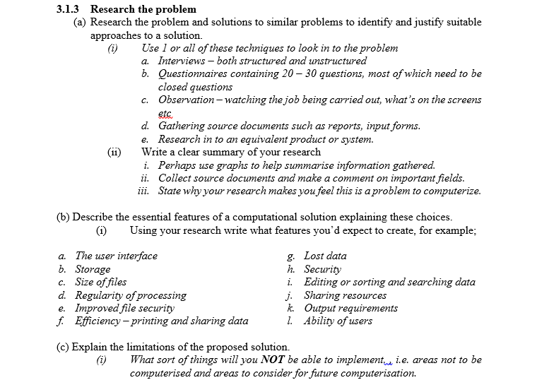
Starting your project

Slide 5
Starting your project
Create a folder called Project documentation
Create a new word file called analysis
Follow what is stated in the guidance.
Have all the subdivisions and titles as is in the guidance.
It directly correlates with the mark scheme and criterior!

Slide 6
Research completion
Completion date – 2/10 – your next lesson with SLS
Start today – complete for IS
A full calendar will be with you soon detailing the schedule for completing the project
You are expected to spend around 6 hours out of class working upon your project. It is a significant undertaking.
You will also be receiving weekly IS from EVC and SLS to work on your theory – topics which have been chosen based on answers from your year 13 test.

Slide 7
Resources
Digital exemplar
Printed exemplar
Mark scheme
Project criterior
Analysis guide

